Slide 1
Abnormality Detection - MURA Data Set
Final Project: Group 1
Pragna Sonpal 001806281
Sayli Bhutkar 001427569
Dhairya Jaiswal 001824902
Mit Katwala 001440383
Ronak Parkhiya 001491072

Slide 2
About data
MURA is a large dataset of musculoskeletal radiographs containing 40,561 images from 14,863 studies, where each study is manually labeled by radiologists as either normal or abnormal.
Each belongs to one of seven standard upper extremity radiographic study types: elbow, finger, forearm, hand, humerus, shoulder, and wrist.
The MURA abnormality detection task is a binary classification task, with each study containing one or more views (images) — and the expected output is a binary label y ∈ {0, 1} indicating whether the study is normal or abnormal, respectively.

Slide 3
Work Flow
Image preprocessing which includes adjusting brightness, contrast and flipping.
Build CNN model by using hidden layers.
Add more layers and change the architecture of your model to get better results.
Fine tune the hyper parameters.
Train your fine tuned model on the whole training data and then evaluate its performance on the test data.
Calculate the kappa score.

Slide 4
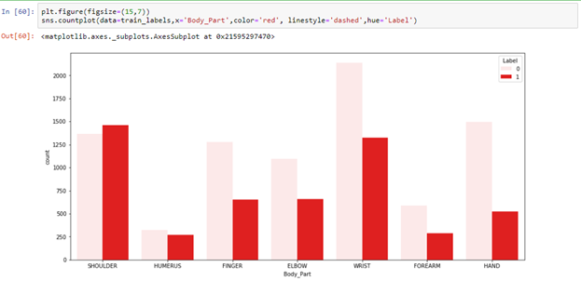
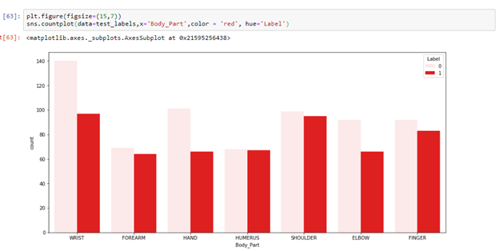

Slide 5
Data loading
Dataset Mura-v1.1 consists of:
'train',
'train_image_paths.csv',
'train_labeled_studies.csv',
'valid',
'valid_image_paths.csv',
'valid_labeled_studies.csv'
From all 6 types of study, we specifically worked on Elbow study data.
Using
def load_path(root_path = 'MURA-v1.1/train/XR_ELBOW', size = 224)
and
def load_image(Path = 'MURA-v1.1/train/XR_ELBOW', size = 224)
functions, image path and images are loaded.

Slide 6
Data Architecture
Path data contains folder wise path to reach the image. Using that path we loaded image in an array named: images.
Array contains pixels values constraint to 224*224 size.
Using the data path, we also done labeling according to positive and negative values associated with it and classified as 1 and 0 respectively.
if root.split('_')[-1]=='positive':
labels+=[1]
else:
labels+=[0]

Slide 7
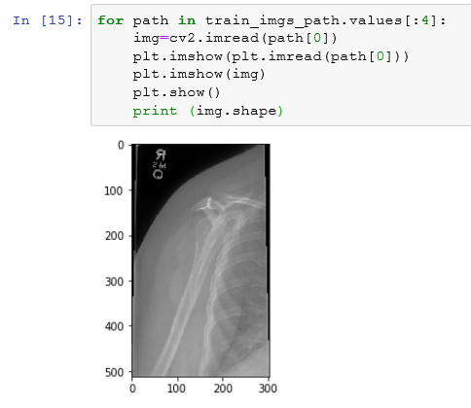
Data Preprocessing
Did random rotation flip on image in the range of angle = random.randint(-30,30) and found +30 as better angel to do rotation.
datagen=ImageDataGenerator(
horizontal_flip=True,
vertical_flip=True,
rotation_range=30,
featurewise_center=False,
featurewise_std_normalization=False,
fill_mode='nearest',
preprocessing_function=preprocess_input,
)
After Processing on image data: images looked like:
Tried changing brightness and contrast of images
but as they are x-ray images in B&W , it made image look extra brighter
which was creating wrong impact on image.

Slide 8
Splitting data
Divided data using load_path and load_image functions mentioned above
where, X_train_path and Y_train has path and labels respectively.
X_valid is an array consists of pixels of images, which has shape of:
(224,224,3)
im_size = 224
X_train_path, Y_train = (load_path(root_path = 'MURA-v1.1/train',size = im_size) )
X_valid_path, Y_valid = (load_path(root_path = 'MURA-v1.1/valid', size = im_size) )
X_valid = (load_image(X_valid_path,im_size) )
Y_valid = np.asarray(Y_valid)

Slide 9
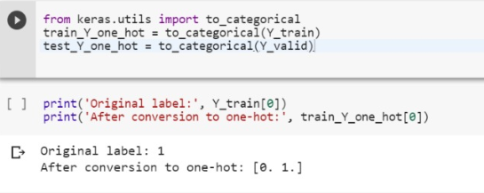
One-hot-encoding
Here, we had Y_train labels as 0 and 1, we converted it to categorical as [0,1] and [1,0] according to positive, negative labels.

Slide 10
Classification using CNN

Slide 11
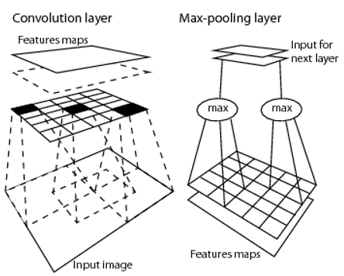
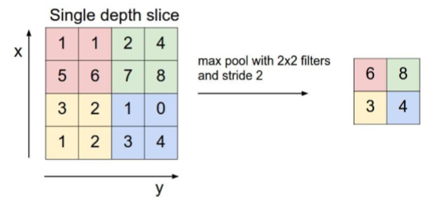
CNN Modelling
Convolution Operation
Nonlinearity (eg. ReLU Layer)
Pooling/Subsampling
Flattening
Full Connection

Slide 12
CNN implementation using varied hyperparameters
1st approach:
No. of convolution layers: 4
No. of pooling layers: 2
Batch size : 64
Epochs: 30
steps per epochs: 10
Accuracy: 0.44

Slide 13
2nd Approach:
No. of convolution layers: 8
No. of pooling layers: 4
Batch size : 64
Epoches: 30
steps per epoches: 10
Accuracy: 0.468

Slide 14
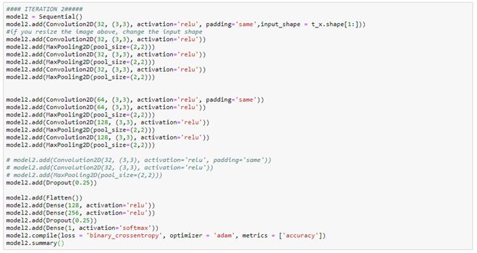
Model Overview

Slide 15
3rd Approach:
No. of convolution layers: 8
No. of pooling layers: 4
Batch size : 8
Epoches: 30
Steps per epochs: 5000
Accuracy: 0.553 ~ 53%
Kappa score: 0.18

Slide 16
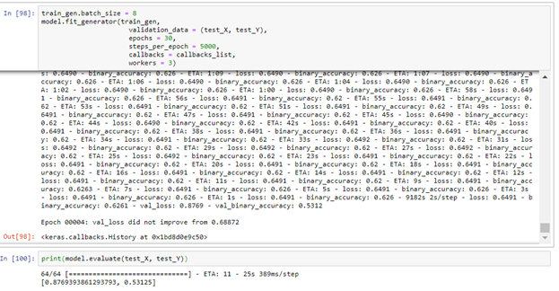
3rd Approach

Slide 17
4th Approach:
Combined 3 models and added to 4th:
No. of convolution layers: 8
No. of pooling layers: 4
Batch size : 8
Epoches: 30
per batch classes: 10
Accuracy: 0.6189
Kappa score: 0.2931

Slide 18
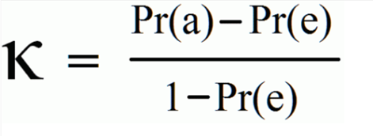
Kappa Score
Cohen’s Kappa statistic is a very useful, but under-utilised, metric. Sometimes in machine learning we are faced with a multi-class classification problem. In those cases, measures such as the accuracy, or precision/recall do not provide the complete picture of the performance of our classifier.
The kappa statistic is used to control only those instances that may have been correctly classified by chance. This can be calculated using both the observed (total) accuracy and the random accuracy. Kappa can be calculated as:

Slide 19
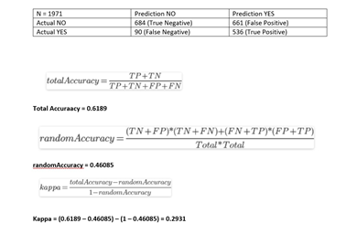

Slide 20
Conclusion
THANK YOU...

